Slide 1
The Role of Complex NLP in Transformers for Text Ranking
David Rau
University of Amsterdam
Amsterdam, The Netherlands
Jaap Kamps
University of Amsterdam
Amsterdam, The Netherlands

Slide 2
Presented By:
Kazi Habibur Rahaman
ID: 20101559
CSE431
Section: 02

Slide 3
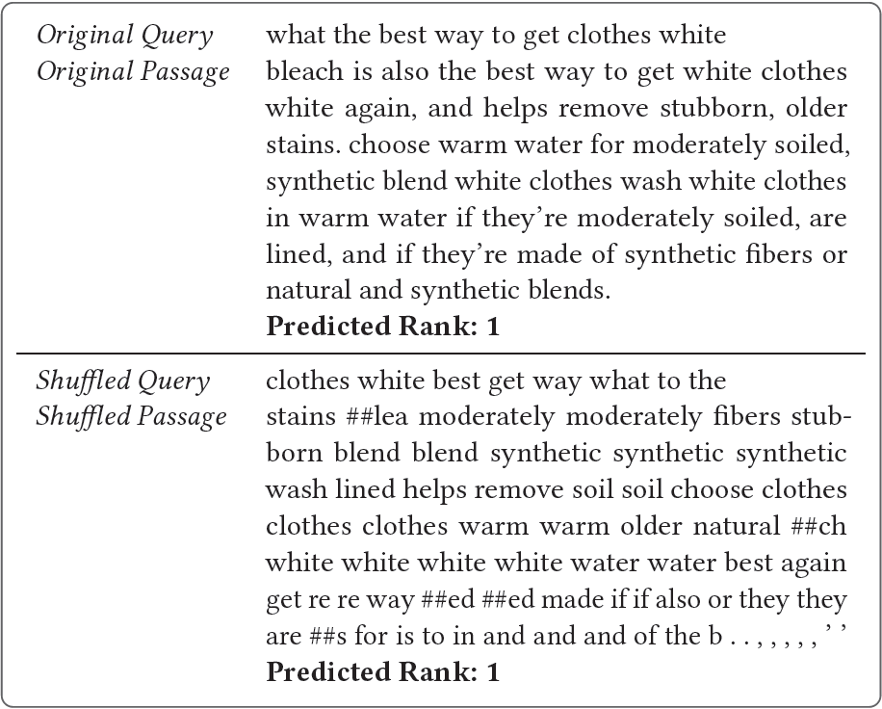
The “syntactic aspects”
Breaking the natural sequence order of the query and passage makes them meaningless to human readers.
But
A model trained on the perturbed sequence estimates its relevance correct

Slide 4
Purpose of the Research Paper:
Investigating the role of complex NLP in transformers for text ranking
Answering the question, “How much is modeling syntactic aspects contributing to the success of BERT in information retrieval?”

Slide 5
Breaking Down the Question into Multiple Research Questions:
RQ1: Does the BERT Cross-Encoder Ranker perform well due to modeling syntactic aspects?
RQ2: What is the effect of removing position information on the ranking performance?
RQ3: Does the model inherently lose order sensitivity while fine-tuning on the ranking task?
RQ4: How different are models that are trained without sequence order?
RQ5: What role does modeling syntactic aspects play in Natural Language Understanding tasks

Slide 6
Experimental Setup:
Model:
BM25 with no stemming, as a first stage ranker
BERT Cross-Encoder (CE) as neural ranker
Data:
Dataset1: MS MARCO dataset, TREC 2020 Deep Learning Track [1]
Dataset2: TREC 2004 Robust Track
Metrics for Evaluation: NDCG@10, MAP and Recall@100

Slide 7
Answering
Research Question 1 and 2:
“Does the BERT Cross-Encoder Ranker perform well due to modeling syntactic aspects?”
“What is the effect of removing position information on the
ranking performance?”

Slide 8
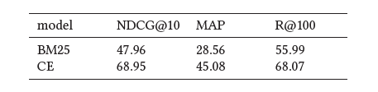
Following the training scheme of Nogueira and Cho [2]:
Performance of BM25 and the BERT Cross-Encoder (CE) on the MSMARCO NIST 2020 testset:

Slide 9
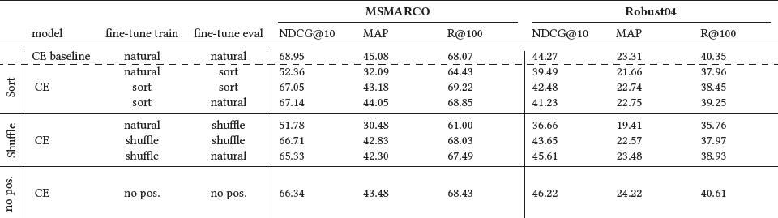
After entering altered (syntax-independent) input in Transformer:

Slide 10
Answers:
RQ1: BERT Cross-Encoder Ranker perform slightly well due to modeling syntactic aspects.
RQ2: Removing position information has negligible effect on the model’s performance. (4% for NDCG@10, 5% MAP, and 2% MRR)
Claim: sequence order is not crucial for the performance of the CE to the extent that a bag-of-words representation without any position information can lead to a comparable performance

Slide 11
Answering
Research Question 3 and 4:
“Does the model inherently lose order sensitivity while fine-tuning
on the ranking task?”
“How different are models that are trained without sequence
order?”

Slide 12
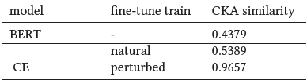
Similarity between natural and shuffled hidden representations:
Centered Kernel-Alignment (CKA) [3] was used to show the similarity between the natural and sorted input
The similarity is bounded between 0 and 1, where 1 means most similar
The batch-wise comparison was carried out over the 2020 NIST testset

Slide 13
Answer to Question no. 3:
CE is less order sensitive compared to the pre-trained BERT model
the model is almost entirely invariant (CKA similarity 0.9657) to order perturbations
Reason:
CE partially learns to ignore sequence order during the fine-tuning process

Slide 14
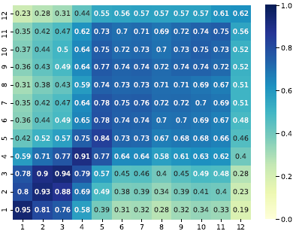
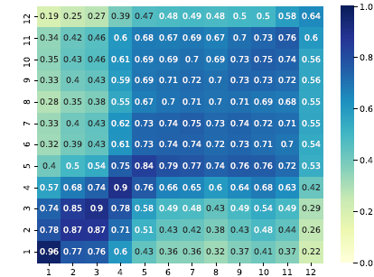
Similarity of the hidden representations of different layers:
Similarity measured between between the CE baseline and CE trained on sorted input
Similarity measured between between the CE baseline and CE trained without position information

Slide 15
Answering Question 4:
Training the model on perturbed input order significantly changes the learned representations, especially for later layers.
Observations for CE fine-tuned without position information are also similar.
Reason:
Word order is being partially maintained within the vanilla CE Ranker as a legacy of the pre-training task causing a drastic change in representations when losing sequence order

Slide 16
Answering
Research Question 5:
“What role does modeling syntactic aspects play in Natural
Language Understanding tasks?”

Slide 17
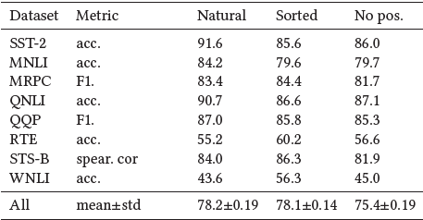
Fine tuning BERT on GLUE dataset [4]:
GLUE consists of nine different sentence or sentence-pair language understanding tasks.
BERT will be fine-tuned separately on each sentences except CoLA as it requires intact sentence structure as input.
BERT fine-tuned on natural order, sorted by token id and without position information

Slide 18
Observation and Answer to Question 5:
Perturbing the input structure yields a marginal decrease from on average 78.2 over all tasks to 78.1 compared to the original input.
Some tasks (RTE, STS-B, and WNLI) performs even better when the sentence structure is broken.
Reason:
Tasks that are based on sentence similarity perform best under no position setting.

Slide 19
Now to the Main Research Question:
“How much is modeling syntactic aspects contributing to the success of BERT in information retrieval?”
Syntax does not seem to play a crucial role in neural ranker
Effect of syntax on fine tuned BERT is around 4%. But then again sentence similarity tasks work better without syntax
In conclusion, Syntax is negligible for Transformers for Text Ranking

Slide 20
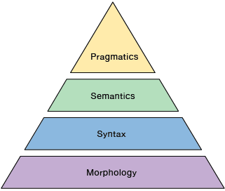
Limitations:
The research paper focuses only on the Syntax’s role
Syntax with other steps maintained during input could have a significant impact on the neural ranker’s efficiency
Though the effect of syntax was not great, it still has some influence on the model’s results. The research paper did not mentioned a quantified value to address this influence.
NLP pyramid. Four hierarchical steps to describe the understanding of natural language.

Slide 21
References:
Payal Bajaj, Daniel Campos, Nick Craswell, Li Deng, Jianfeng Gao, Xiaodong Liu, Rangan Majumder, Andrew McNamara, Bhaskar Mitra, Tri Nguyen, et al. 2016. MS MARCO: A human generated machine reading comprehension dataset. (2016). arXiv:1611.09268
Rodrigo Nogueira and Kyunghyun Cho. 2019. Passage Re-ranking with BERT. (2019). arXiv:1901.04085
Simon Kornblith, Mohammad Norouzi, Honglak Lee, and Geoffrey E. Hinton. 2019. Similarity of Neural Network Representations Revisited. CoRR abs/1905.00414 (2019). arXiv:1905.00414 http://arxiv.org/abs/1905.00414

Slide 22
References:
Alex Wang, Amanpreet Singh, Julian Michael, Felix Hill, Omer Levy, and Samuel R. Bowman. 2019. GLUE: A Multi-Task Benchmark and Analysis Platform for Natural Language Understanding. In the Proceedings of ICLR.

Slide 23
Thank You

